Slide 1
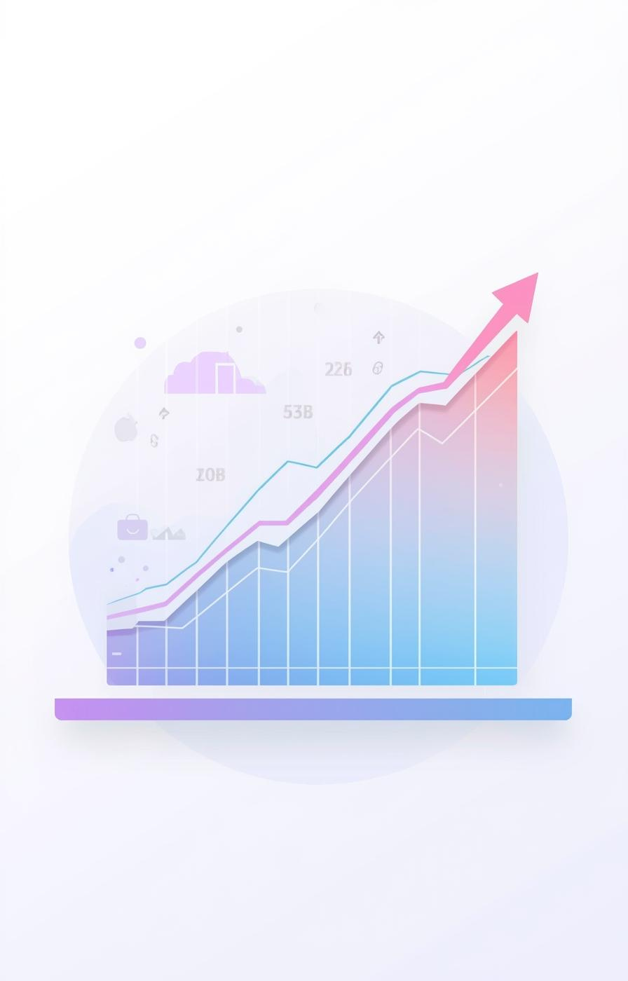

Stock Vision – Stock Price Prediction
Pooja (GU-2024-1740), MCA 3rd, GNA University

Slide 2

Understanding the importance of stock predictions
The stock market is inherently volatile, influenced by various economic, political, and global factors. With these fluctuations, it has become increasingly important for investors to have systems in place that can effectively analyze market variations and provide accurate insights. Machine Learning has emerged as a powerful tool in this regard, enabling sophisticated financial time-series forecasting. The "Stock Vision" platform aims to simplify the investor's decision-making process by integrating data collection, visualization, and prediction in a user-friendly web interface, ultimately enhancing investment strategies.

Slide 3

Predicting stock prices manually is extremely challenging and imprecise.
Traditional analysis methods cannot handle large datasets efficiently.
Investors lack a central platform that combines real-time data, analytics, and ML predictions.
Stock volatility makes it difficult to identify trends without computational support.
There is a need for a tool that provides clear visual insights + reliable predictions to assist users.
Problem Statement
Challenges in Stock Price Prediction
3

Slide 4
Project Objectives
Key goals for Stock Vision implementation
Functional System
Automation Process
Advanced Prediction
Build a fully operational machine learning-based stock prediction system that efficiently analyzes market data and provides reliable forecasts for investors.
Automate the fetching and preprocessing of real-time historical stock data to ensure accuracy and timeliness in predictions, enhancing user experience and system reliability.
Implement LSTM (Long Short-Term Memory) models to achieve high accuracy in time-series predictions, leveraging sequential patterns in stock prices to inform investment decisions.
4

Slide 5
System Architecture Overview
01
User Interface
04
Visualization
Streamlit provides a user-friendly input interface.
Visualizations display data trends and predictions clearly.
02
API Layer
05
Prediction Display
Yahoo Finance supplies historical stock data efficiently.
Real-time trends are showcased for user analysis.
03
Preprocessing Layer
Preprocessing enhances data for accurate model predictions.

Slide 6
Methodology Overview
01
Data Collection
04
Model Development
Utilizes yfinance for historical stock data.
Involves designing and training LSTM layers.
02
Cleaning
05
Evaluation
Prepares data by removing inconsistencies and missing values.
Analyzes performance using RMSE and MSE metrics.
03
Transformation
Converts data into suitable formats for LSTM training.

Slide 7
Technologies Used
01
Python
04
TensorFlow/Keras
Python is the core programming language utilized.
TensorFlow/Keras builds and trains neural network models.
02
NumPy & Pandas
05
Streamlit
Used for powerful data manipulation and analysis tasks.
Streamlit deploys the machine learning application effectively.
03
Matplotlib & Plotly
They provide stunning visualizations of data and predictions.

Slide 8
Data Preprocessing
01
Features
04
Normalization
Relevant features include Open, Close, High, Low, Volume.
Data is normalized using Min-Max scaling techniques.
02
Missing Values
05
Sequence Division
Missing data is handled by replacement or removal.
Data is divided into fixed-length sequences for LSTM.
03
Test Set
A separate test set is created for validation.

Slide 9
Visual Analysis Techniques
01
Line Charts
Display stock movement over selected periods effectively.
02
Candlestick Charts
Provide detailed insights into price patterns and trends.
03
Volume Bars
Indicate buying and selling pressure over time visually.

Slide 10


Conclusion
Stock Vision” successfully predicts future stock prices using LSTM.
Integrates end-to-end workflow: data collection, preprocessing, modeling, and deployment.
Provides intuitive visualizations that support decision-making.
Offers a fast, lightweight platform suitable for learners, traders, and researchers.
Meets project goals by delivering a functional, interpretable prediction tool.
Empowering investment decisions through ML

